Slide 1
Lightweight Deep Neural Network for Imbalanced Binary Dataset Classification with Dice-Loss in NLP
Yunhu Kim
4/28/2024

Slide 2
Introduction
The study uses Dice Loss, approximated differentiable F1 score as loss function
We used lightweight Deep Average Neural Network (DAN)
There has been some changes in formula for Dice loss and experiment set up.
We removed Feed Forward Neural Network as DAN because it process dataset better.
Applied Sigmoid Function to prediction to change to probability.

Slide 3
Model
Model: ReLU Deep Averaging Neural Network.
Loss functions for comparison:
Dice Loss (proposed loss function)
Mean Squared Error Loss (MSE Loss)
Weighted Binary Cross Entropy Loss functions.

Slide 4
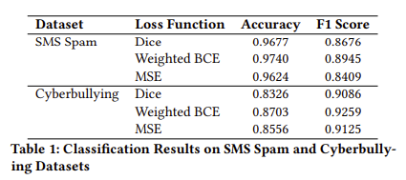

Experiment Set up and result
Word Embedding:
glove-wiki-gigaword-50
Model Configuration:
3 Layers of ReLu DAN
Result:
Weighted Binary Cross Entropy Performs best, Dice Loss and MSE performed similarly.
The dataset was too easy. It was hard to find out best loss function
Changed:
DAN instead of FFNN
Applied sigmoid to predicted out in Dice Loss function.

Slide 5
Analysis
Analysis:
Weighted Binary Cross Entropy Performs best, Dice Loss and MSE performed similarly.
Because dataset was too easy, Even MSE loss function could have addressed imbalanced dataset too easily.
Hard to find best loss function.
Future Work:
Find harder dataset.
Modify loss function to address multi-classification problem.
Work in more complex AI model such as RNN, LSTM, or transformer.

Slide 6
Thank You
Purdue Marketing and Communications, marcom.purdue.edu

